Slide 1
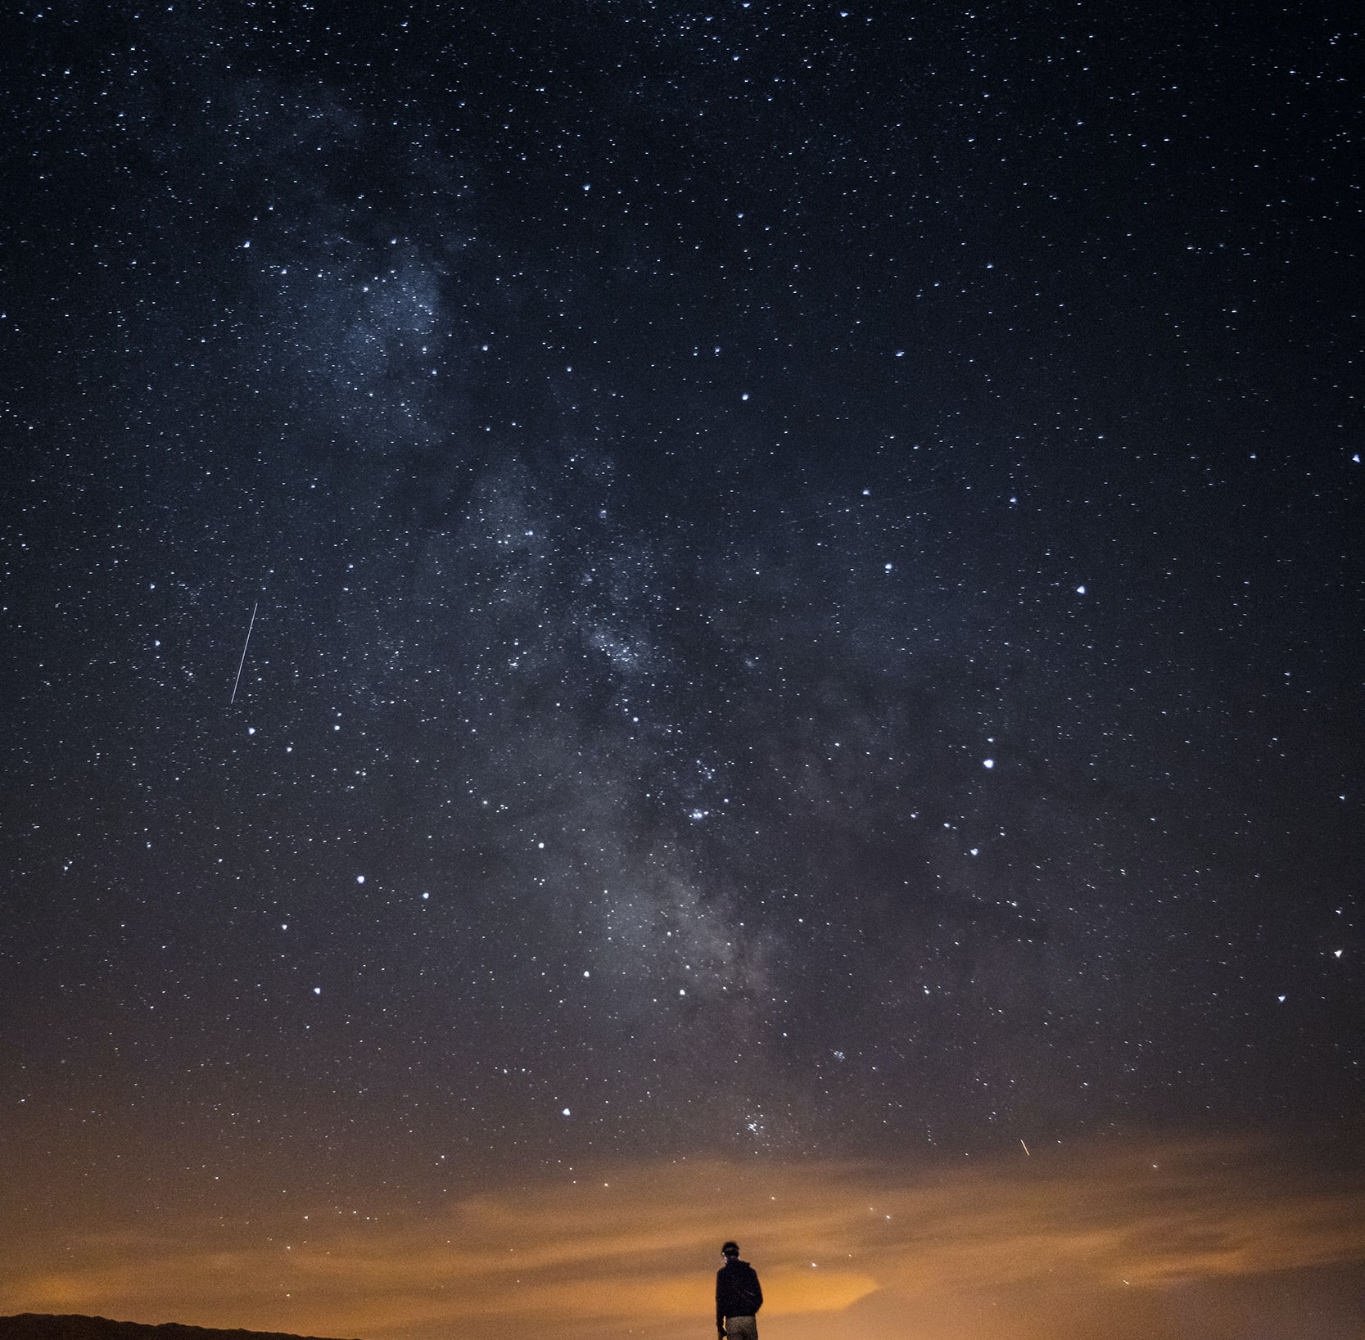

Creative Programming and Computing
Music and Acoustic Engineering
«E quindi uscimmo a riveder le stelle»
Inferno XXXIV, 139
Creative Programming and Computing
Music and Acoustic Engineering
Politecnico di Milano
Federico Ceriola – Gian Marco De Bortoli – Bruno Sciarrone
a.a. 2021/2022

Slide 2
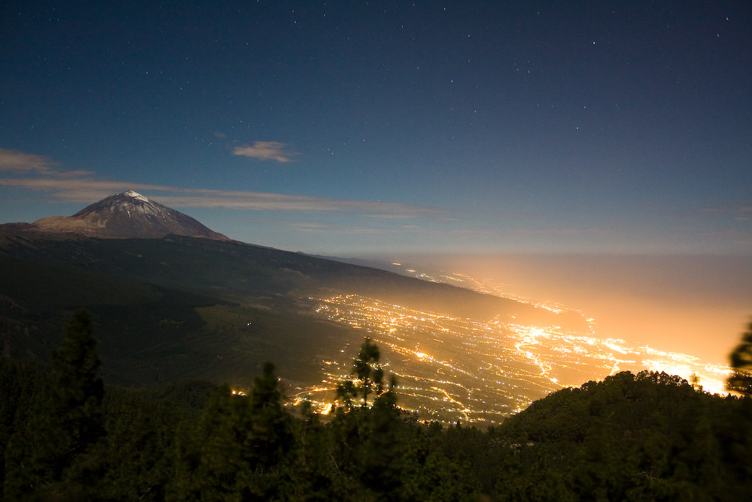
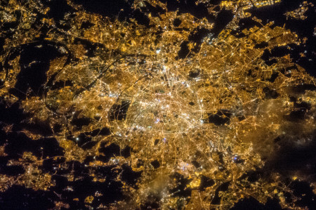
Creative Programming and Computing
Music and Acoustic Engineering
Main Concept:
Lights pollution in the dark sky:
Light Pollution unnecessarily contributes to climate change.
Light pollution kills millions of birds a year.
Artificial light at night disrupts the seasonal cycle of trees.
Relevant number of people have never seen the real sky at night (the Milky Way).
Exposure to artificial light at night puts your health at risk.
Federico Ceriola – Gian Marco De Bortoli – Bruno Sciarrone
a.a. 2021/2022

Slide 3


Creative Programming and Computing
Music and Acoustic Engineering
Our Story:
Interactive Installation
Imagine you could switch off all the artificial lights above your head.
You would be able to see the real natural light of the dark sky.
It would be the same experience of a child discovering the world, with equal curiosity and astonishment.
Visual and sound discovering experience
Federico Ceriola – Gian Marco De Bortoli – Bruno Sciarrone
a.a. 2021/2022

Slide 4
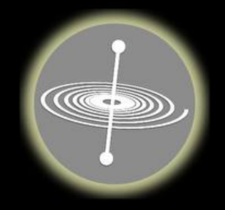

Creative Programming and Computing
Music and Acoustic Engineering
User’s interaction
SIGNAL ROUTING
Auxiliary Audio Out
OSC messages
GyrOSC
Audio signal
Video signal
Processing
Max4Live
Ableton Live
Video Out
Audio Out
Perception
Federico Ceriola – Gian Marco De Bortoli – Bruno Sciarrone
a.a. 2021/2022

Slide 5
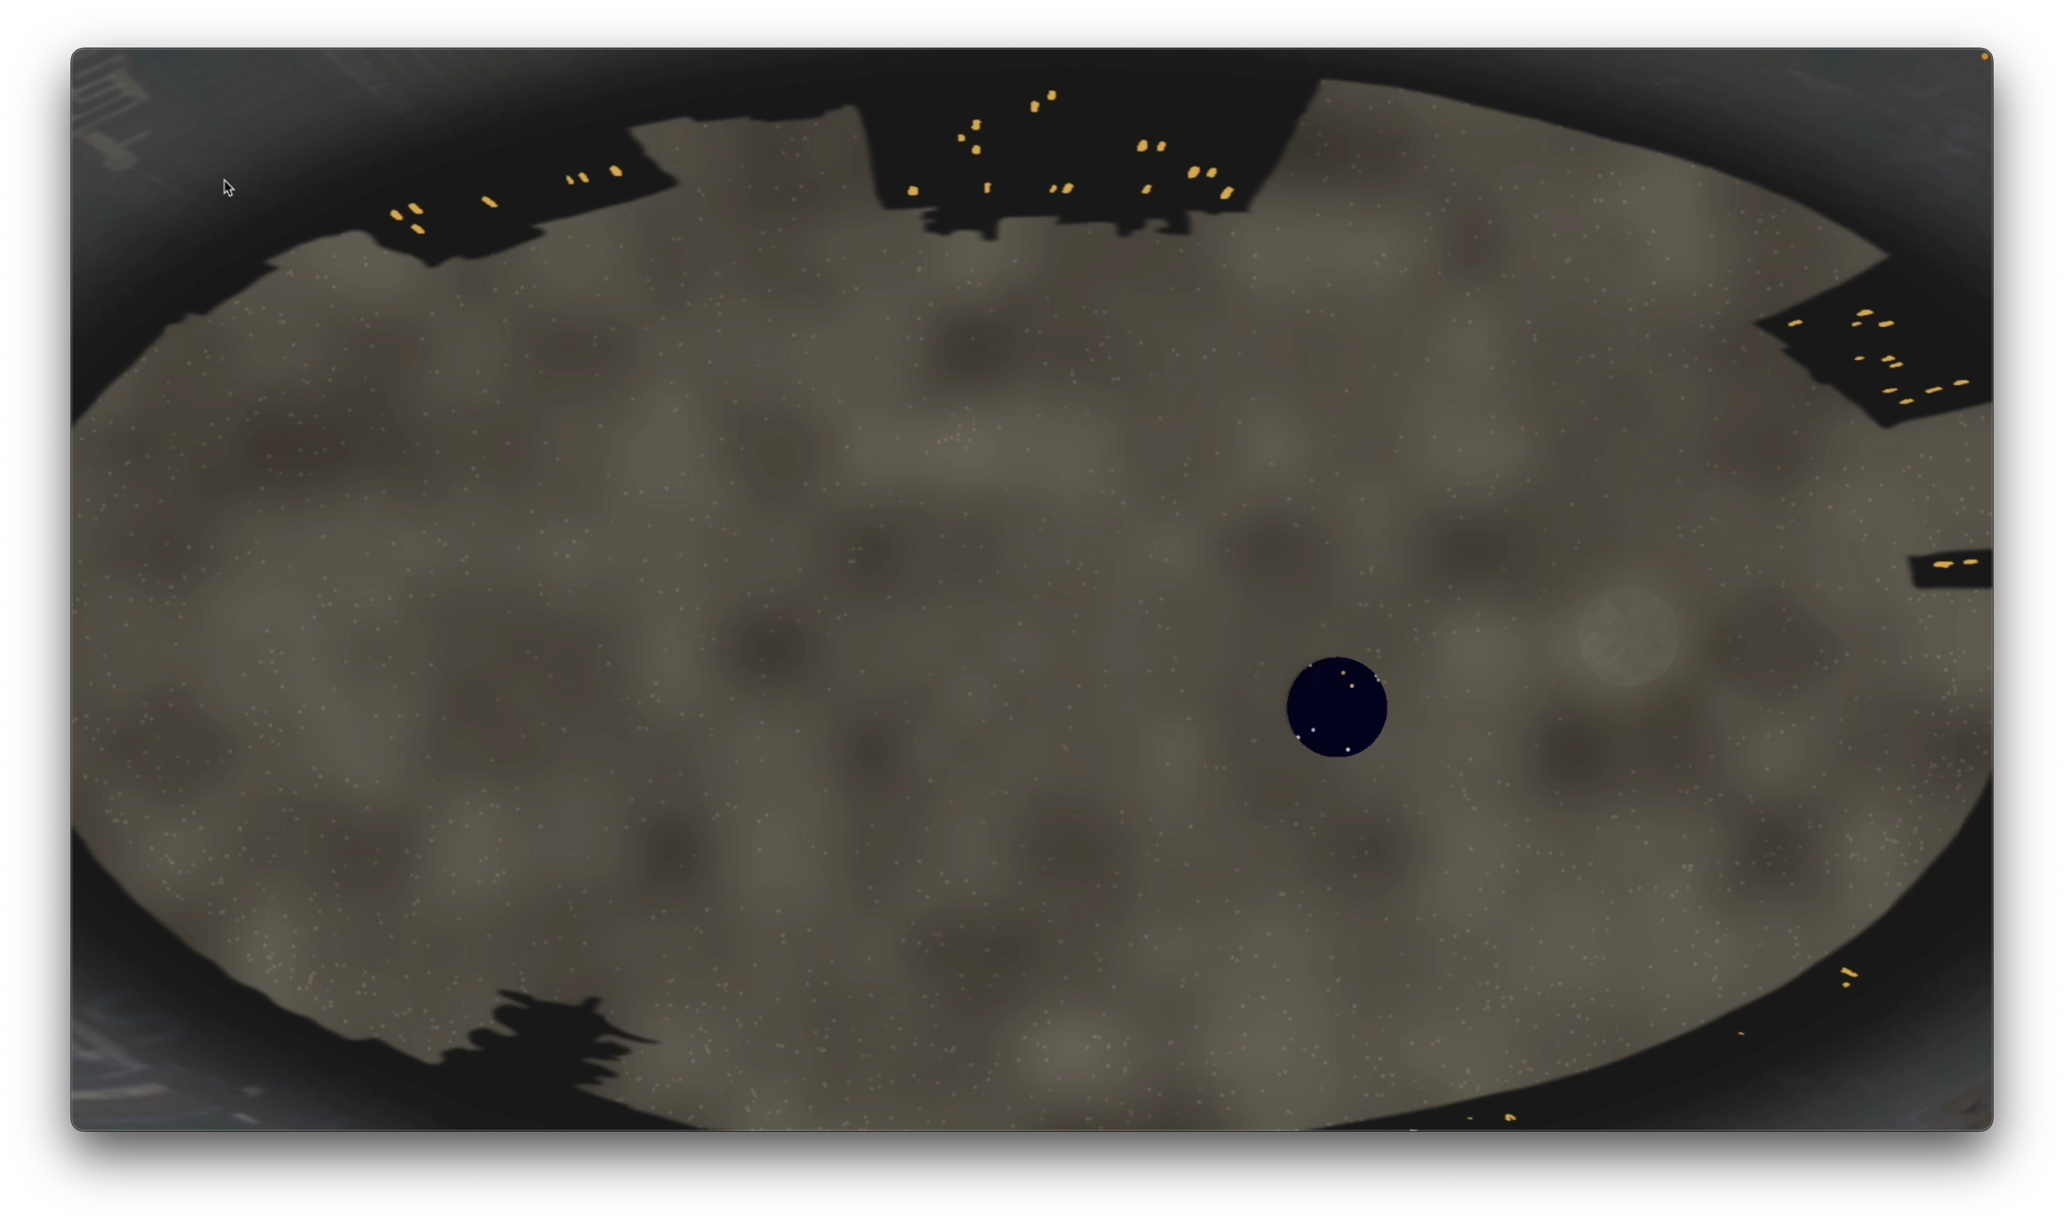
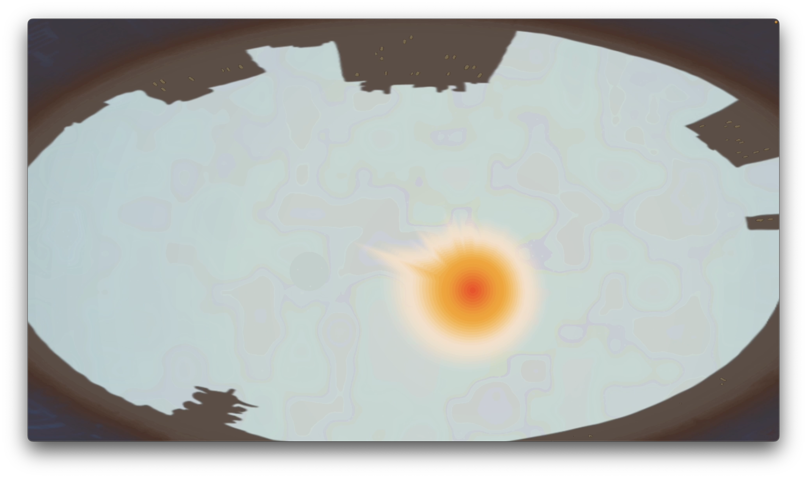
Creative Programming and Computing
Music and Acoustic Engineering
Design - Overview
Two main scenarios with different elements
Night time:
Interaction with the stars
Presence of the Moon
Visible pollution
Day time:
Less intuitive interaction
Presence of the Sun
Immersive experience
Federico Ceriola – Gian Marco De Bortoli – Bruno Sciarrone
a.a. 2021/2022

Slide 6
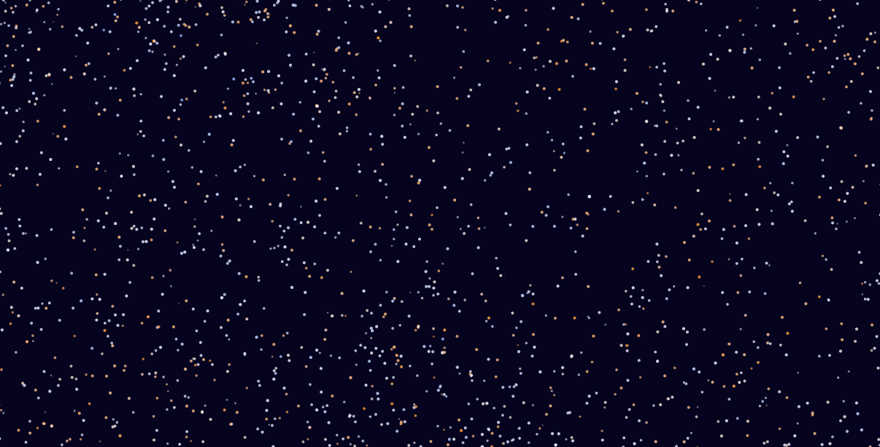
Creative Programming and Computing
Music and Acoustic Engineering
Stars
The star plot is based on:
Real database with information about coordinates (J2000), temperature and visual magnitude
Current time at application first launch
GPS position of the user
Projection in cartesian coordinates
Colour based on the temperature
Dimension and Opacity based on visual magnitude
Federico Ceriola – Gian Marco De Bortoli – Bruno Sciarrone
a.a. 2021/2022

Slide 7
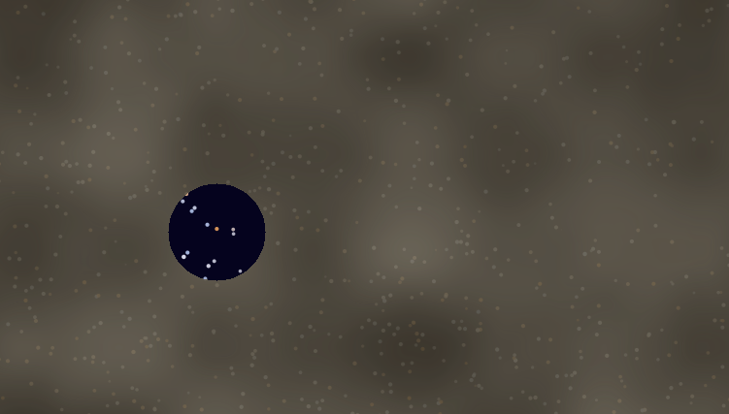
Creative Programming and Computing
Music and Acoustic Engineering
Pollution
The light pollution simulation is obtained with the 3D Perlin Noise technique.
The coordinates used are:
x coordinate of the pixel
y coordinate of the pixel
time t
From the cone of visibility we gather information about:
density of stars
dominant colour
Federico Ceriola – Gian Marco De Bortoli – Bruno Sciarrone
a.a. 2021/2022

Slide 8
Creative Programming and Computing
Music and Acoustic Engineering
Sky
It is obtained with:
colour interpolation
opacity controlled by sound intensity
Moon
Rendered with the use of the 2D Perlin Noise
Sun
Built with concentric rays each representing a scaled version of the sound amplitude spectrum
Federico Ceriola – Gian Marco De Bortoli – Bruno Sciarrone
a.a. 2021/2022

Slide 9
Creative Programming and Computing
Music and Acoustic Engineering
Interaction – OSC messages
Federico Ceriola – Gian Marco De Bortoli – Bruno Sciarrone
a.a. 2021/2022

Slide 10
Creative Programming and Computing
Music and Acoustic Engineering
Sound Generation
Federico Ceriola – Gian Marco De Bortoli – Bruno Sciarrone
a.a. 2021/2022

Slide 11
Creative Programming and Computing
Music and Acoustic Engineering
The sky
Three layers
1. Pollution
An oppressive veil of smokey glare from the city lights covers the view of the stars.
The flashlight is the tool able to «clean the dirt».
3. Universe
A clear night sky with diffused colors recalling different galaxies serves as background for the picture.
2. Stars
Glowing points of different pale colors and dimensions distributed all over the screen for the user to interact with.
Gian Marco De Bortoli – Federico Ceriola
a.a. 2021/2022

Slide 12
Creative Programming and Computing
Music and Acoustic Engineering
Pointing Mechanism
The «torch» indicates a point on the screen (the red one) that is the center of a circle.
Every star that is inside the circle interact from a sounding point of view depending on:
Distance from the center
Dimensions
Brillance
Color
Gian Marco De Bortoli – Federico Ceriola
a.a. 2021/2022

Slide 13
Creative Programming and Computing
Music and Acoustic Engineering
Messages Chain
Video Interaction
Processing
OSC send
Ableton:
OSC receiver
Sound Generation
Audio Split
OUT 1-2
to the PA
OUT 3-4
SuperCollider:
OSC receiver
MIDI notes generator
OSC send
Gian Marco De Bortoli – Federico Ceriola
a.a. 2021/2022

Slide 14
Creative Programming and Computing
Music and Acoustic Engineering
Additional elements
The sun:
The sensation of time flow is introduced by the presence of the sun.
The user is in mid-interaction with the application when this entity enters the scene stealing the control away from the user’s hands and recalling the feeling of a life inside a polluted city.
An immersive experience:
The user is not just a spectator, he/she is the main character of the story.
From the camera we capture the scene and we project it onto the screen as if the separation between the physical world and the virtual world was just the same window separating the child from the city.
Gian Marco De Bortoli – Federico Ceriola
a.a. 2021/2022

